Slide 1
ZERO KNOWLEDGE PROOFS
1

Slide 2
Contents
Interactive Proofs
How to convince others (that you know something)?
Zero-Knowledge Proofs (ZKP)
Proofs that reveal nothing (about what you know)
Non-interactive ZKP
Using the Fiat-Shamir Heuristic
Succinctness
Can the proof that you know something be shorter than (or even independent of) the length of what you know?
ZK-SNARKs
Using Quadratic Arithmetic Programs & Bilinear Pairings

Slide 3



Standard Proof
Prover
Verifier
REJECT
ACCEPT
Prover sends the actual proof to the Verifier
3

Slide 4
Efficient Verifiability

Slide 5
CLASS NP

Slide 6
EXAMPLES of Languages in NP

Slide 8
OR

Slide 9
Idea of an interactive proof
Verifier has randomness.
Probabilistic conclusion.
Interactive in nature.
How does it help?
Efficiently verifiable proofs beyond NP?
Zero-Knowledge proofs?
Succinct proofs for NP?
What “extra” assumptions can bring back non-interactive proofs for NP (without trading off succinctness and zero-knowledge)?
9
Notes:
9

Slide 10
How to assure Prover?
Completeness property
If Prover doesn't lie, Verifier will accept
(with probability 1)
10
Notes:
10

Slide 11
How to assure Verifier?
Soundness property
If Prover lies, Verifier will reject
(with high probability)
11
Notes:
11

Slide 12
Example of an Interactive Proof
Prove to a colorblind friend that two balls are differently colored
12
Notes:
12

Slide 13
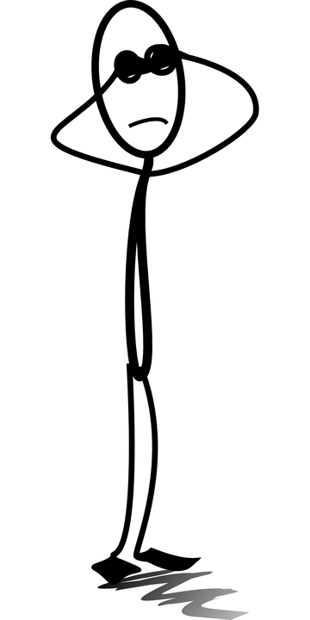
Simple Interactive Proof
Completeness: If they are of different colors
randomness
Prover
Verifier
ACCEPT
Since they are differently colored the Prover will be able to answer correctly every single time
Verifier hides the balls behind his back and either interchanges them or not and then asks the prover to guess what he did.
After k correct guesses, Verifier accepts the proof
13

Slide 14
Simple Interactive Proof
Soundness: If they are of same color
randomness
Prover
Verifier
REJECT
Since they are same color Prover can only guess correctly with probability ½ that the balls have been flipped or not
Prover can be correct in k consecutive rounds with probability 2^{-k}
Verifier hides the balls behind his back and either interchanges them or not and asks the Prover to guess what he did.
Even one wrong guess = reject.
Verifier will reject wrong proof with high probability
14

Slide 15
Going beyond NP:
Think of proving the knowledge of winning strategies in games:
Interactive proof: Just play the game several times!

Slide 16
But what if there is a secret
Prover asks Verifier to check her proof of the Riemann hypothesis.
Verifier copies it, publishes it, and wins a million dollars.
(plus tenure at Harvard!)
Or, consider the blockchain transaction verification computation, with only the hash values public.
You need to prove that there exists a valid transaction that takes the pre-hash to post-hash
16
Notes:
16

Slide 17
Enter Zero Knowledge
Zero Knowledge (ZK) property
The verifier shouldn’t gain any knowledge from the interaction
17
Notes:
17

Slide 18
Zero-Knowledge Proofs
Interactive proofs that reveal nothing other than validity of the assertion being proven
Major part of cryptographic protocols
18

Slide 19
Example of a ZKP
Is a given graph 3-Colorable?
19
Notes:
19

Slide 20
Graph 3-Coloring (G3C)
Label graph vertices using only 3 colors:
(red, green, blue here)
??
non-3-colorable graph
3-colorable graph
20

Slide 21
Why choose G3C?
G3C is NP-Complete

Slide 22
NP-COMPLETENESS THEORY Let’s digress a bit!

Slide 28
where

Slide 31
Similarly, the other direction can be proved.

Slide 33
Back to Zero-Knowledge!

Slide 34

ZK Proof for Graph 3-Coloring
common input
Prover
(unbounded)
Verifier
(poly-time)
1
2
6
??
3
5
4
34
Notes:
explain defn of pi(G_0)
How to prove that two graphs are nonisomorphic???

Slide 35
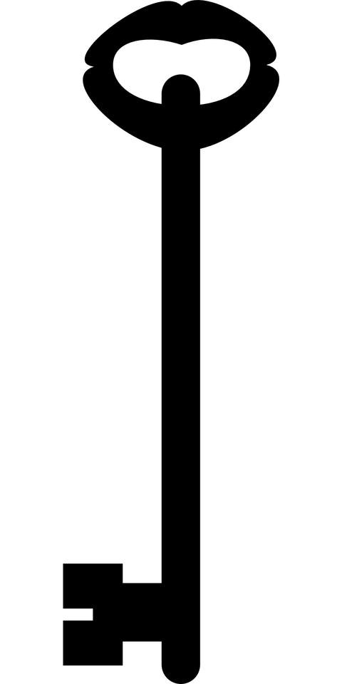
Prover side computation
Select random permutation and color
1
2
6
1
2
3
4
5
6
3
5
4
2. Lock the vertices in individual boxes
35
Notes:
35

Slide 36
Completeness: Honest Prover
common input
Prover
(unbounded)
Verifier
(poly-time)
1
2
6
3
5
4
1. Permute, color, lock and send
2,4
2. Pick random edge (u,v) eg: (2,4)
3. Send keys for vertices u,v (here 2,4)
4. Accept for the round since colors are different
Completeness: Prover honest; accept after k rounds
36
Notes:
explain defn of pi(G_0)
How to prove that two graphs are nonisomorphic???

Slide 37
Soundness: Dishonest Prover
common input
Prover
(unbounded)
Verifier
(poly-time)
1
2
6
??
3
4
5
??
1. Permute, color, lock and send
4,5
2. Pick random edge (u,v) eg: (4,5)
3. Send keys for vertices u,v (here 4,5)
4. Reject since colors are same
Soundness: Prover lies; reject in k^{th} round ( high probability)
37
Notes:
explain defn of pi(G_0)
How to prove that two graphs are nonisomorphic???

Slide 38
Formalizing Zero Knowledge
Verifier learns nothing if it could have “simulated” the interaction on its own.

Slide 39


Simulator for 3-Coloring
1
6
2
5
3
4
Randomly guess verifier’s challenge, e.g. (2,6)
Prepare commitments.
Run verifier.
If guessed correctly, complete simulation. Else try again
(2,6)
Notes:
WLOG G_0 and G_1 have the same vertex set V (Verifier can check this, and reject otherwise).

Slide 40
How to Design the “Boxes”?
Crypto to the rescue!
40

Slide 41
Commitment Scheme
Receiver
Sender
Commit Phase
m∈{0,1}
Reveal Phase
m
Prover reveals value by sending the key
Prover commits using a key and commitment scheme
41

Slide 42
Commitment Properties
Binding: Sender can't change m after commit
Hiding: Receiver can’t see m before reveal
42

Slide 43
Using one-way functions
f : D → D
bijective
One-way
Easy to compute
Hard to invert
Commit Phase
Choose a random r
Send f(r) and (h(r) ⨁m)
Reveal Phase
Send r and m
Example:
f(r) = g^{r} mod p
h(r) = MSB(r)
43

Slide 44
3-Coloring with commitment
common input
Prover
(unbounded)
Verifier
(poly-time)
1
2
6
3
5
4
com( )….com( )
1. Permute, color, lock and send
2,4
2. Pick random edge (u,v) eg: (2,4)
3. Send keys for vertices u,v (here 2,4)
( ,K₂),( ,K₄)
4. Accept since colors are different
44
Notes:
explain defn of pi(G_0)
How to prove that two graphs are nonisomorphic???

Slide 45
ZKP for Discrete Logarithm Problem Why study DLP?

Slide 46
Interactive ZKP for DLP
P claims to know x, given y = g^{x} mod p
Random V
P
T = g^{V}
C
R = V - Cx
V
Random C
Check: T = g^{R}y^{C}
Completeness: g^{R}y^{C} = g^{(V-Cx)}g^{xC} = g^{V} = T

Slide 47
Quick Recap & Next-Up
Interactive Proofs
How to convince others (that you know something)?
Zero-Knowledge Proofs (ZKP)
Proofs that reveal nothing (about what you know)
NEXT …
Non-interactive ZKP
Using the Fiat-Shamir Heuristic
Succinctness
Can the proof that you know something be shorter than (or even independent of) the length of what you know?
ZK-SNARKS
Using Quadratic Arithmetic Programs & Bilinear Pairings
47
Notes:
47

Slide 48
The Fiat-Shamir Heuristic

Slide 49
Non-Interactive ZKP for DLP: Fiat-Shamir Heuristic
P claims to know x, given y = g^{x} mod p
Random V
P
T = g^{V}
C = H(g,y,T)
R = V - Cx
V
Check: T = g^{R}y^{C}
SCHNORR SIGNATURES

Slide 50
What about succinctness?

Slide 51
Succinctness from PCP Theorem and Merkle Trees
The PCP Theorem states that proofs for any NP language can be encoded in such a way that their validity can be verified by only reading a constant number of bits, and with an error probability that is upper bounded by a constant.

Slide 52
ZK-SNARKs from QAPs

Slide 53
First Main Ingredient in ZK-SNARKs
Encoding as a problem of polynomial divisibility, namely Quadratic Arithmetic Programs (QAPs)

Slide 54
Second Main Ingredient in ZK-SNARKs
Succinctness by evaluation of polynomials at some random abscissa value

Slide 55
Third Main Ingredient in ZK-SNARKs
Bilinear Pairing based cryptography for homomorphic computation/verification in encrypted domain, using a common reference string (CRS)

Slide 56
Last Main Ingredient in ZK-SNARKs
Achieving Zero-Knowledge by random blinding

Slide 57
Encoding arithmetic circuits as QAPs

Slide 60
BILINEAR GROUPS

Slide 61
Roadmap for SNARKs

Slide 62
Extra terms computed by the Prover
Verification

Slide 63
SNARKs from QAP

Slide 64
Adding ZERO-KNOWLEDGE

Slide 65
Note that if the polynomial t(x) divides V(x)W(x) – Y(x) then, t(x) also divides the following for randomly chosen d_{v},d_{w} and d_{y}:
[V(x) + d_{v}t(x)] [W(x) + d_{w}t(x)] - [Y(x) + d_{y}t(x)]

Slide 67
SUMMARY
Interactive Proofs
Enables us go beyond NP (if NP ≠ PSPACE)
Zero-Knowledge Proofs (ZKP)
For all NP (eg. G3C)
Non-interactive ZKP for DLP
Using the Fiat-Shamir Heuristic
ZK-SNARKs
Zero-Knowledge Succinct Non-Interactive Arguments of knowledge

Slide 68
Thank you
Any questions?
68

